Slide 1
I-76 Viaduct –Case study Quantification and Diagnosis of Excessive Vibration

Slide 2
Motivation & Objectives
PennDOT owns and operates a bridge along the Schuylkill Expressway in Philadelphia that routinely receives complaints about excessive vibration levels. The goal of this effort was to help PennDOT understand the extent of the problem and then develop effective mitigation strategies, if needed.
Specifically, the following three objectives were identified to guide this study:
Quantify the level of vibration displayed by the I-76 viaduct under normal operating conditions and compare with established criteria
If the vibration levels are deemed unacceptable based on the results of (1), identify the mechanisms that give rise to the large vibration levels
Identify and evaluate a series of interventions to reduce the level of vibration

Slide 3
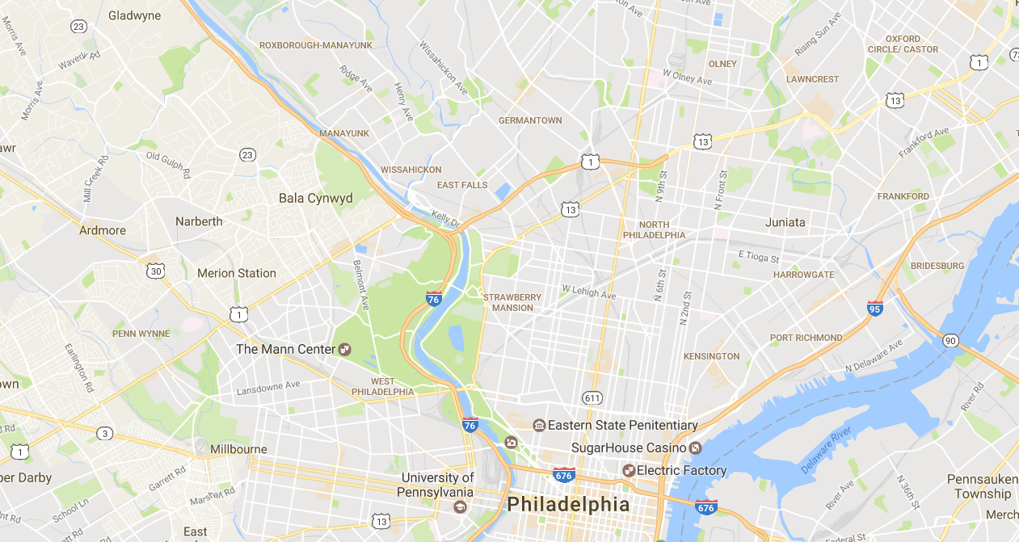
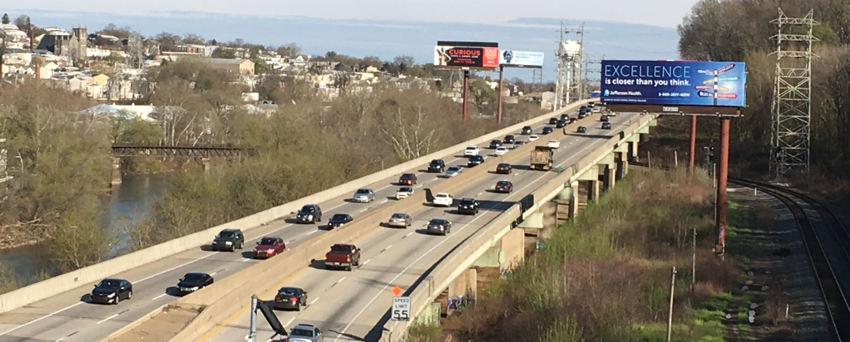
Overview of the I-76 Pencoyd Viaduct
I-76 PENCOYD VIADUCT
Case Studies of Technology Leveraging to Address Bridge Performance Concerns

Slide 4
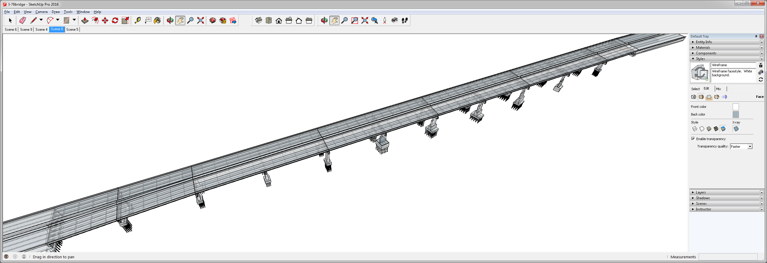
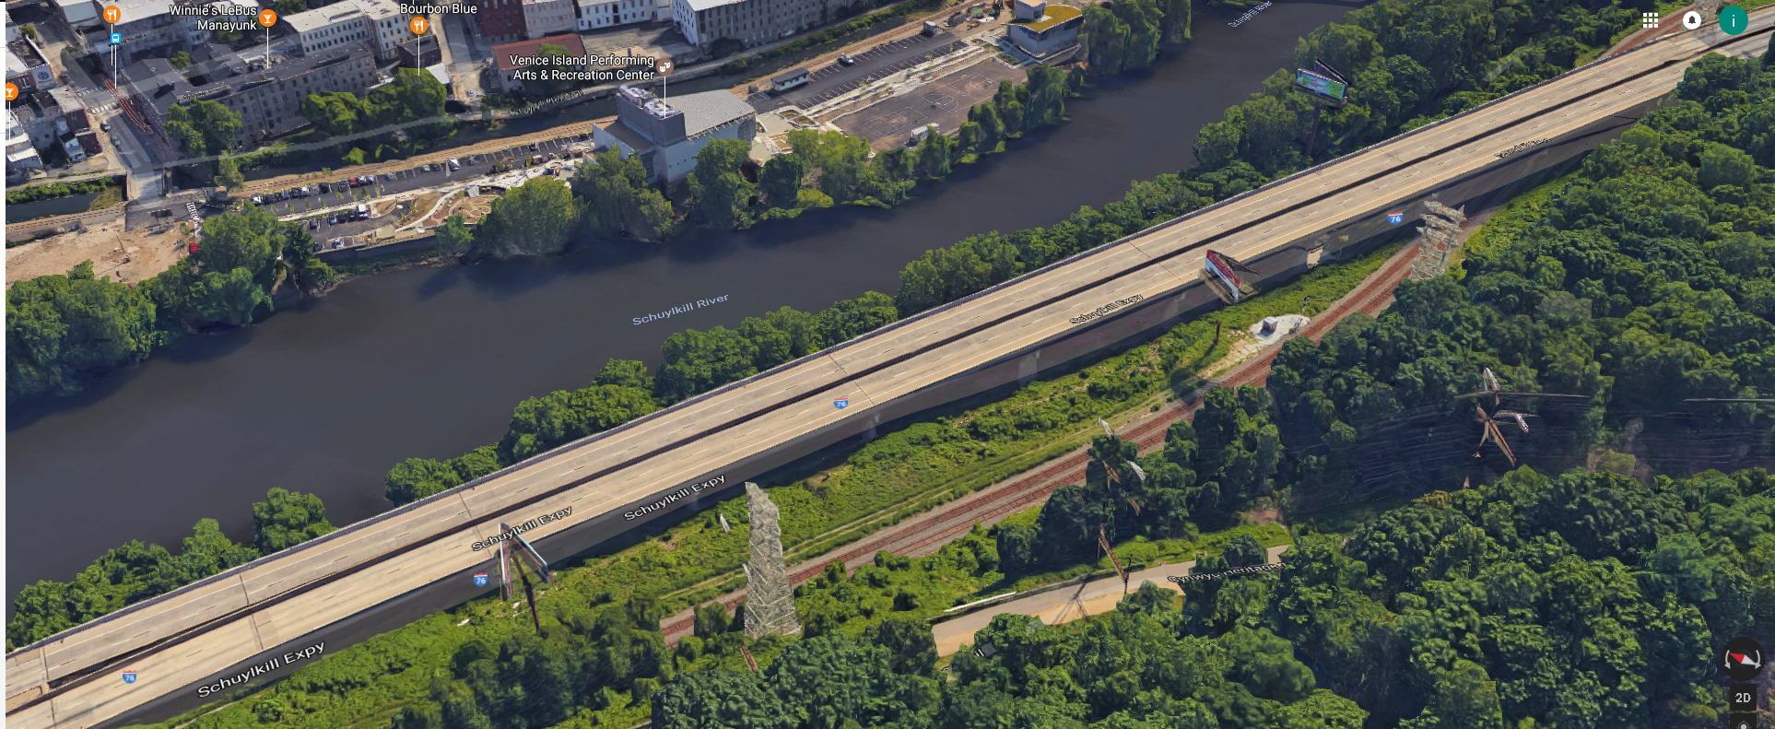
Overview of the I-76 Pencoyd Viaduct
I-76 PENCOYD VIADUCT
Expansion of I-76 is being contemplated
Unknown cause of excessive vibration clouds replacement vs retrofit decision
Decision related to the Pencoyd Viaduct has significant influence over feasibility of the overall project
Span 10
Span 8
Span 9
Span 6
Span 7
Span 4
Span 5
WESTBOUND
Span 2
Span 3
EASTBOUND
Span 1

Slide 5
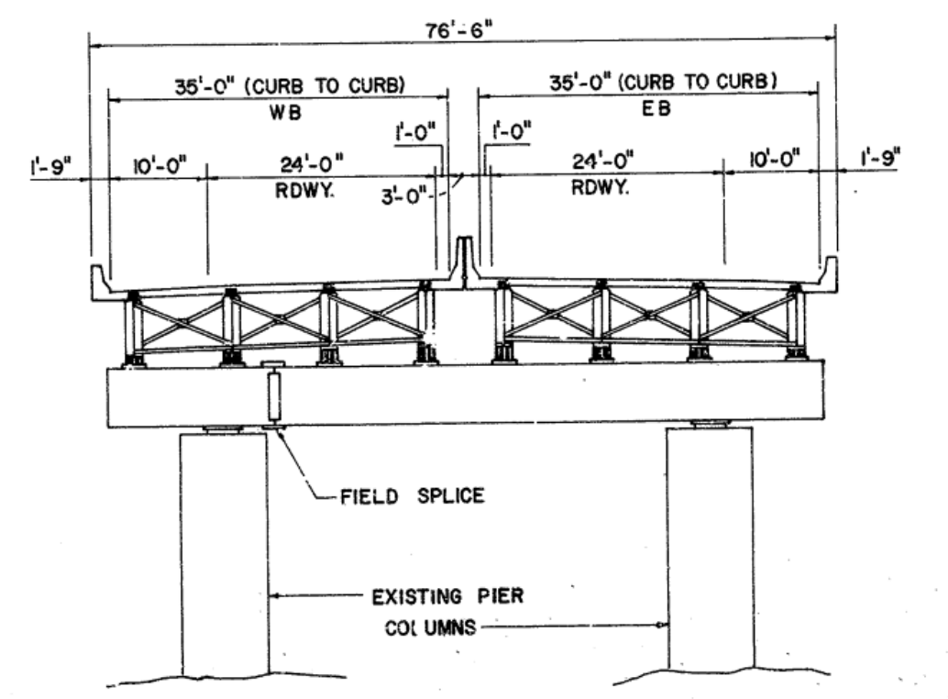
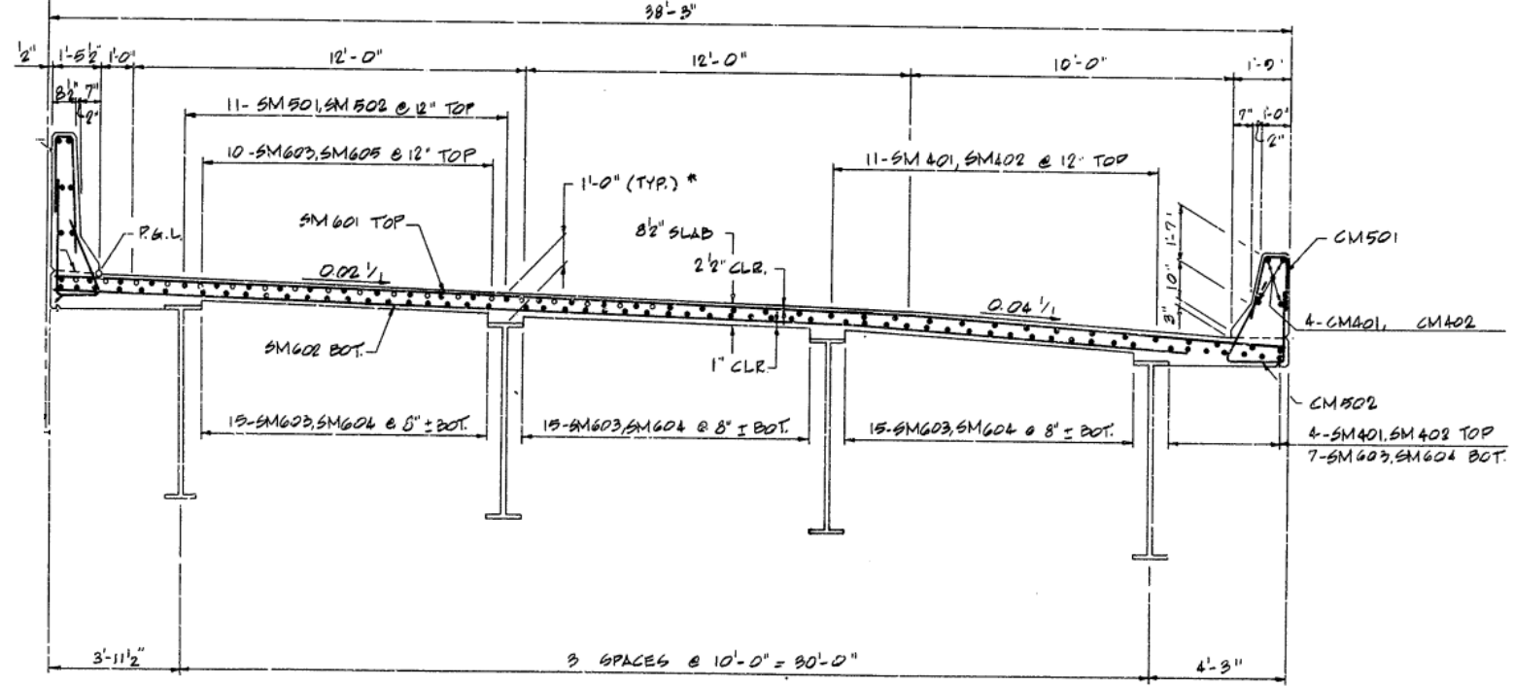
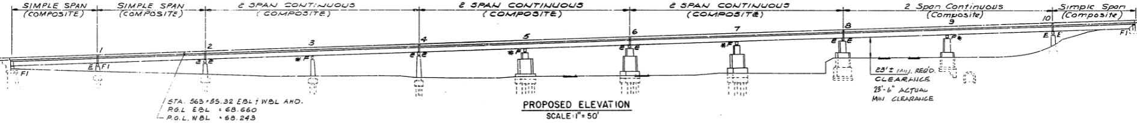
Overview of the I-76 Pencoyd Viaduct
I-76 PENCOYD VIADUCT (1986)
Half section Span 7 and 8
Cross section
Elevation

Slide 6
Research Scope (Crawl, Walk, Run)
Phase 2 – Detailed characterization of selected span(s), including strains, displacements, modal frequencies, and mode shapes
Phase 1 – Quantify the levels and spatial variation of vibration
Phase 3 – Development and calibration of an FE model for the viaduct
Phase 4 – Synchronized bridge/vehicle monitoring
Vehicle System
Interface
Bridge System
Phase 6 – Direct measurement of bridge profile
Phase 5 – Simulation of bridge/vehicle interaction
“Digital Twin”

Slide 7
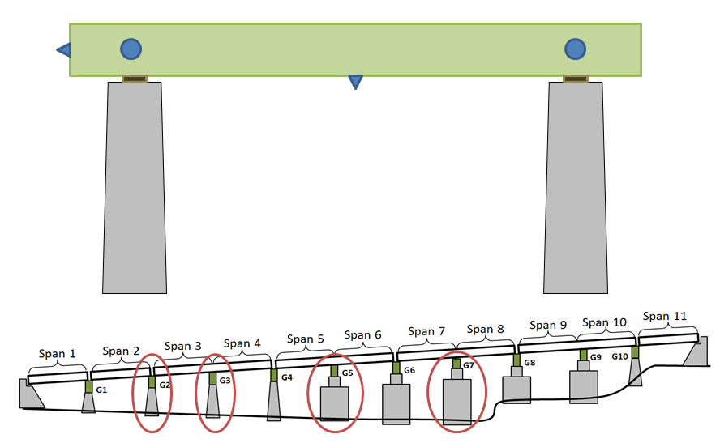
Phase 1 – Preliminary Screening

Slide 8
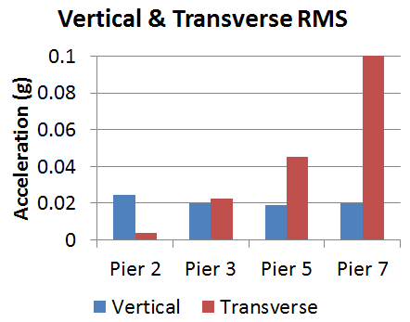
Phase 1 – Preliminary Screening Results
Identify locations experiencing greatest vibration levels
Similar vibrations on all instrumented spans
Spans 7 & 8 chosen

Slide 9
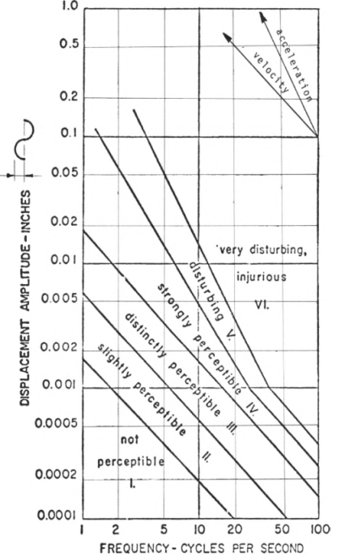
Phase 1 – Preliminary Screening Results
Characterize vibration
Magnitude: 0.25g
Frequency Content: 2-3 Hz
Evaluate using human comfort criterion: ≈ ½”

Slide 10
Research Scope (Crawl, Walk, Run)
Phase 2 – Detailed characterization of selected span(s), including strains, displacements, modal frequencies, and mode shapes
Phase 1 – Quantify the levels and spatial variation of vibration
Phase 3 – Development and calibration of an FE model for the viaduct
Phase 4 – Synchronized bridge/vehicle monitoring
Vehicle System
Interface
Bridge System
Phase 6 – Direct measurement of bridge profile
Phase 5 – Simulation of bridge/vehicle interaction
“Digital Twin”

Slide 11
Phase 2 – Detailed Monitoring
To satisfy the objectives, a deeper knowledge of the structure was required.
The objectives for the monitoring effort were as follows:
Characterize operational vibrations and strains at critical locations and locations of maximum response under various traffic conditions
Gather data for modal parameter identification (i.e. frequencies and mode shapes)

Slide 12
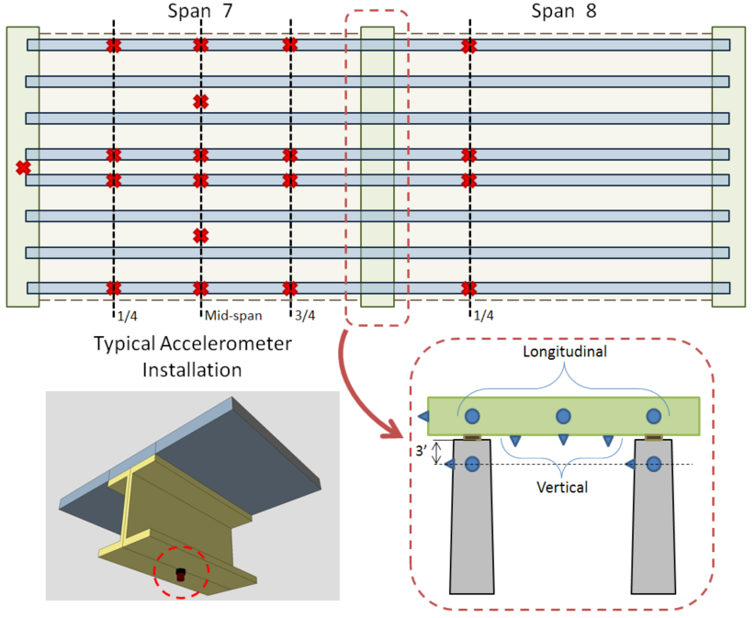
Phase 2 Instrumentation Plan (Acceleration)
30 accelerometers
Recorded a total of 14 hours of data

Slide 13
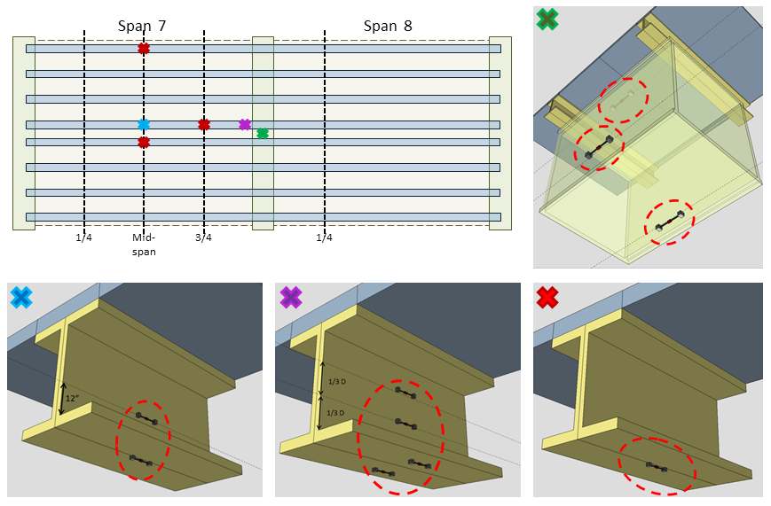
Phase 2 Instrumentation Plan (Strain)
12 - 6” vibrating wire accelerometers installed with epoxy
Sampled at 50Hz for 12 hours; at 20Hz for additional 8 hours over night

Slide 14
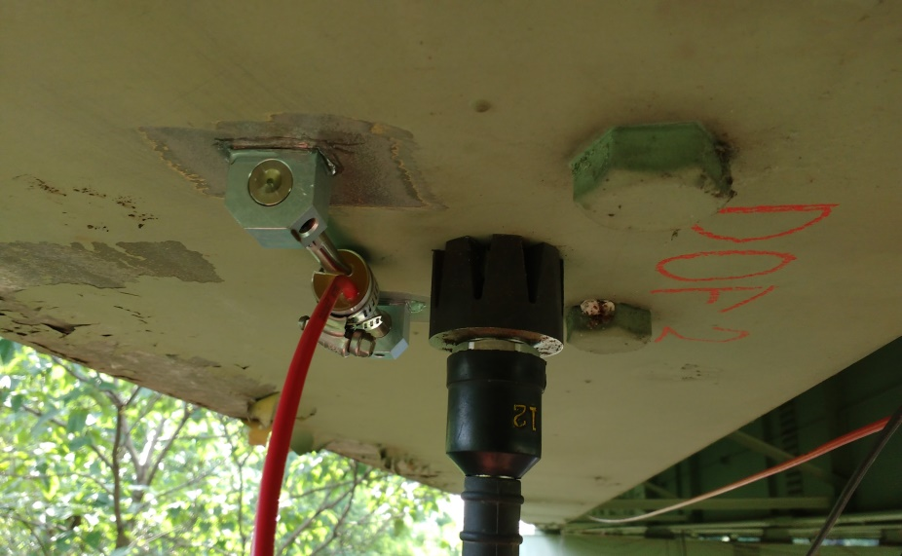
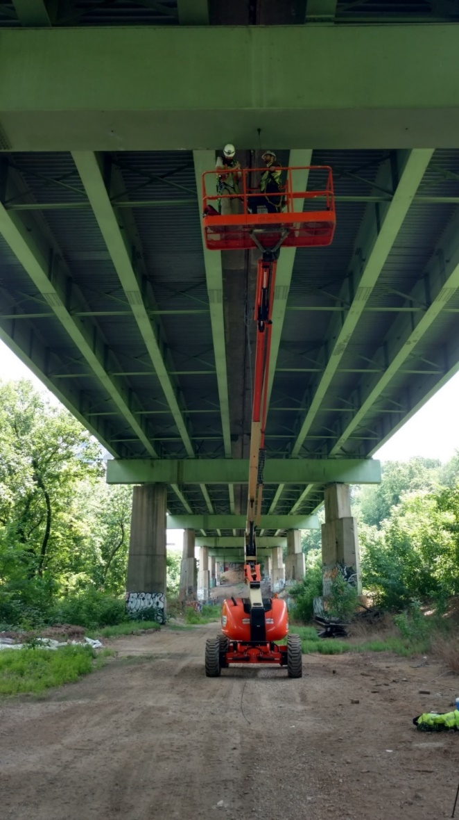
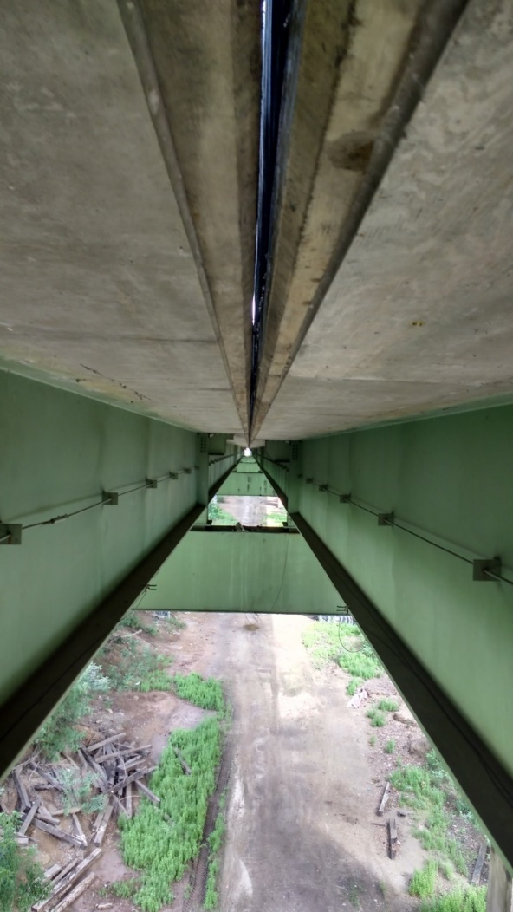
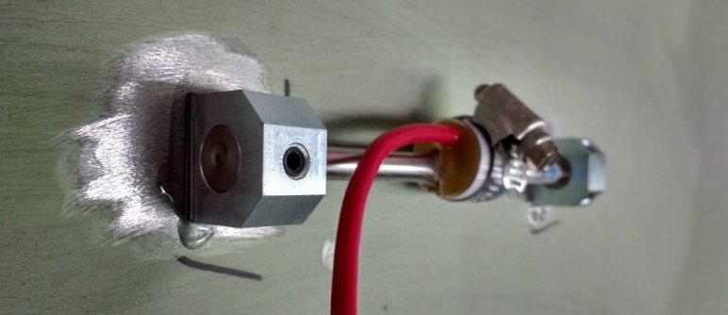
Case Study: I-76 Pencoyd Viaduct
First Test: Operational vibration and strain monitoring
INSTRUMENTATION PLAN
30 Accelerometers
12 Strain Gauges
24 hours of data collected

Slide 15
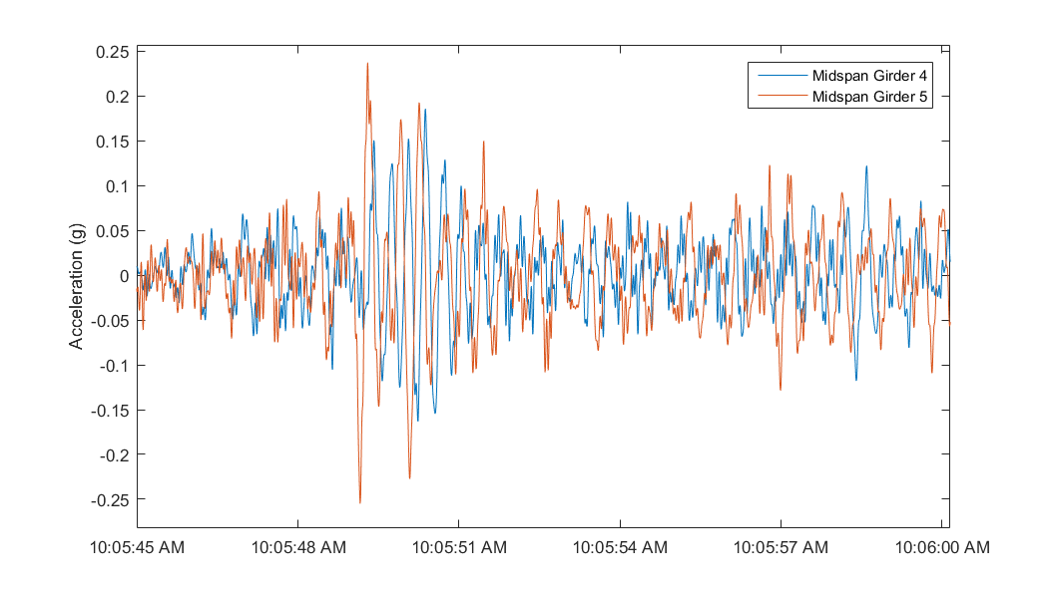
Phase 2 – Results (Acceleration)
Filtered acceleration of girders (midspan-vertical) is consistently 10% g with peaks as high as 25%g
Many apparent repeated mode shapes due to geometry (2 bridges side by side)
1st mode at 2 Hz
At least 9 modes (all of which are 1st bending/torsion) between 2 and 4 Hz
Filter: 6th order low-pass elliptic filter with 0.5 dB of passband ripple and 40 dB of stopband attenuation and a passband edge frequency of 20 Hz.

Slide 16
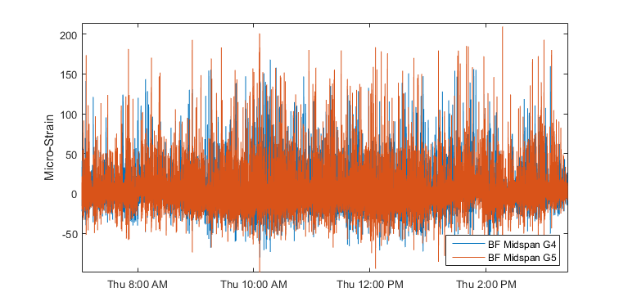
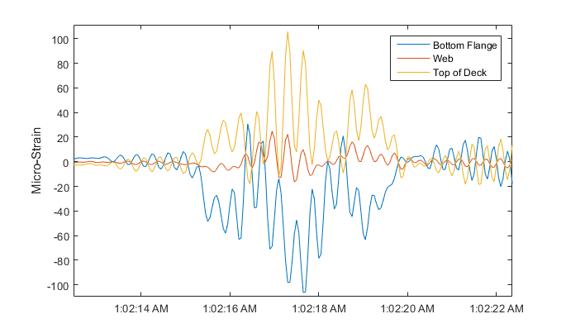
Phase 2 – Results (Strain)
6 hour window
Concrete Tension: 350 psi
Extrapolated stress/strain in concrete deck at levels for which long term fatigue cracks begin to form
Bottom flange strain frequently exceeds 100 με with occasional spikes above 200 (6ksi)

Slide 17
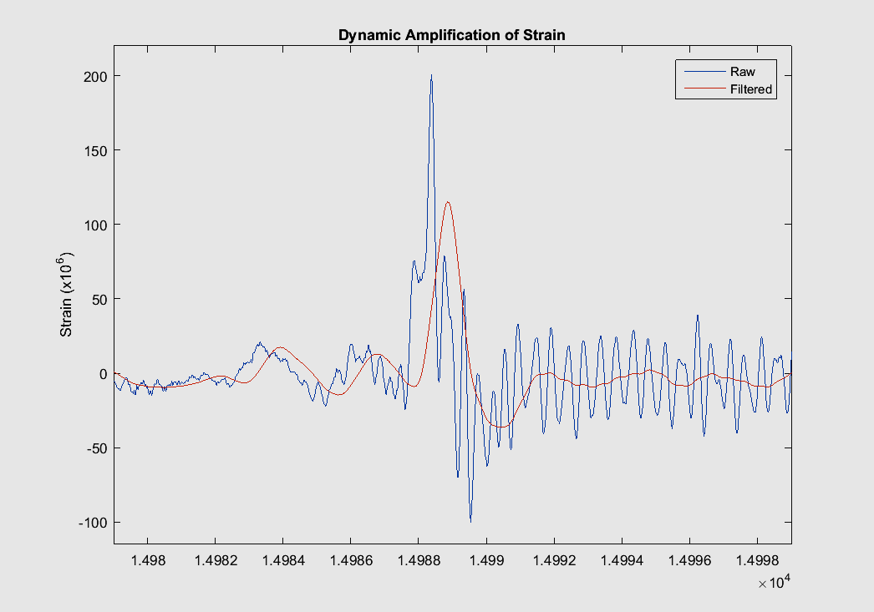
Phase 2 – Results (Dynamic Amplification)
Dynamic amplification =
~1.75-2.0 = Dynamic Response
Static Response
Dynamic response
~Static response

Slide 18
Research Scope (Crawl, Walk, Run)
Phase 2 – Detailed characterization of selected span(s), including strains, displacements, modal frequencies, and mode shapes
Phase 1 – Quantify the levels and spatial variation of vibration
Phase 3 – Development and calibration of an FE model for the viaduct
Phase 4 – Synchronized bridge/vehicle monitoring
Vehicle System
Interface
Bridge System
Phase 6 – Direct measurement of bridge profile
Phase 5 – Simulation of bridge/vehicle interaction
“Digital Twin”

Slide 19
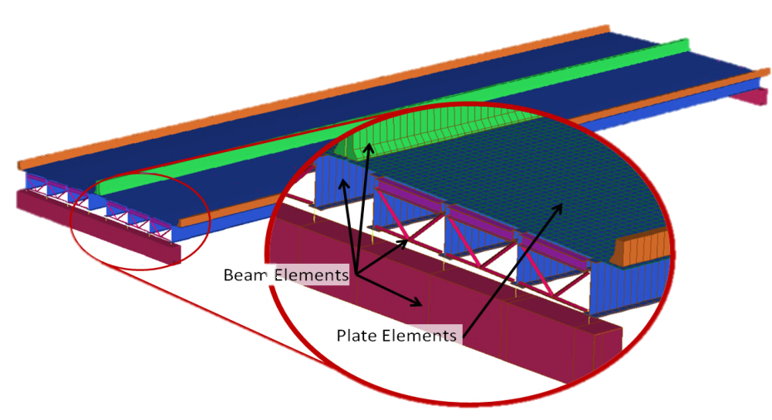
Phase 3 – Model Development
A 3D “Element-level” FE model of Spans 7 & 8 was constructed.
Girders, diaphragms, and barriers represented as beam elements
Deck represented as plate elements
Link elements to maintain consistent with 3D geometry

Slide 20
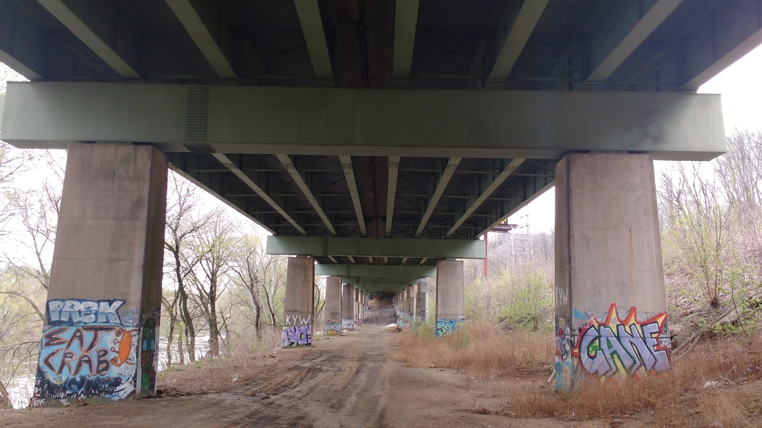
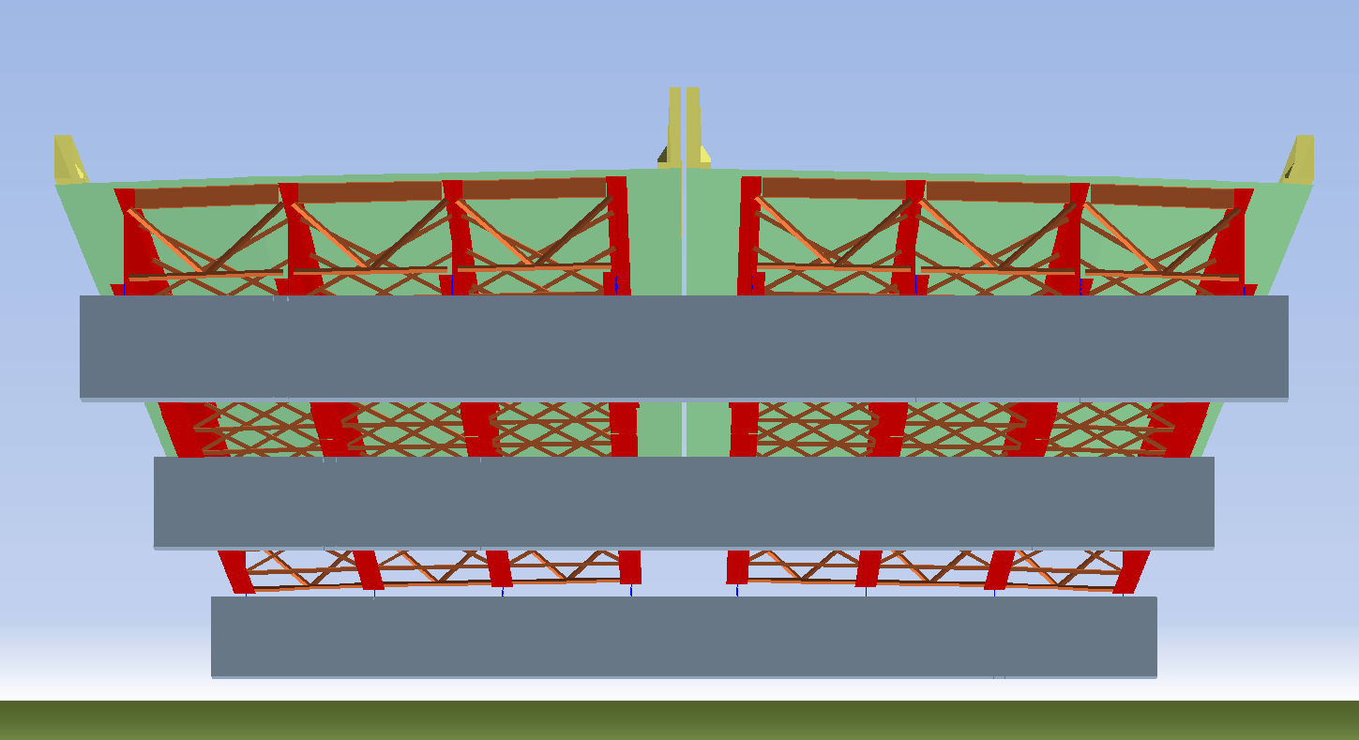
Phase 3 – Model Development

Slide 21
Model Calibration
Experimental data used for the updating
Modal frequencies
Mode shapes
Updated parameters
Boundary conditions
Continuity conditions (composite action, barrier participation)
Material properties
Conclusions – The a priori was consistent with the measured results once the stiffness of the barriers was removed

Slide 22
Simulation of Calibrated Model
A detailed comparison between the updated model with models typically employed during design will be carried out by December. This study will include a comparison of the following:
Operational live load stress/strain compared to Strength I and Service II design limit states
Refined 3D FE model compared to design predicted stress/strain (conservatism associated single-line girder approximation)
Influence of the measured versus assumed dynamic amplification factor
Examine infinite life/fatigue thresholds

Slide 23
Phase 3 - Conclusions
33% Amplification Factor
There are no abnormalities with bridge.
All components appear to be in good functional order.
The bridge rates
The calibrated model had final parameters and form within reasonable bounds
This iteration of St-ID yielded no answer to the question: “why does the bridge experience large vibrations.”
This supports the conclusion that the observed response is due to bridge/vehicle interaction as opposed to a characteristic of the bridge itself.
Further investigation is required to meet Objectives 2 and 3
Location | Strength I (Flexure) | Service II (Flexure)
Girder 4 Midspan | 1.60 | 1.73
Girder 5 Midspan | 1.86 | 1.98
75% Amplification Factor
Location | Strength I (Flexure) | Service II (Flexure)
Girder 4 Midspan | 1.21 | 1.32
Girder 5 Midspan | 1.41 | 1.50

Slide 24
Research Scope (Crawl, Walk, Run)
Phase 2 – Detailed characterization of selected span(s), including strains, displacements, modal frequencies, and mode shapes
Phase 1 – Quantify the levels and spatial variation of vibration
Phase 3 – Development and calibration of an FE model for the viaduct
Phase 4 – Synchronized bridge/vehicle monitoring
Vehicle System
Interface
Bridge System
Phase 6 – Direct measurement of bridge profile
Phase 5 – Simulation of bridge/vehicle interaction
“Digital Twin”

Slide 25
Phase 4 – Vehicle-Bridge Testing
The high levels of vibration and dynamic amplification are a feature of the structure, but they are also a result of the traffic loading and its interaction with the structure.
To better understand this interaction and the mechanisms and parameters to which it is sensitive, a test was conducted for which the bridge and a vehicle was instrumented. The following objectives were established to guide the test:
Record bridge response due to a known input (test vehicle)
Investigate bridge-vehicle interaction
Identify scenarios that result in the largest amplifications
To accomplish these objectives we needed to address the following challenges:
Characterize vehicle (mass and suspension)
Record bridge and vehicle response simultaneously and synchronously
Record vehicle location on the structure
Record traffic patterns during testing

Slide 26
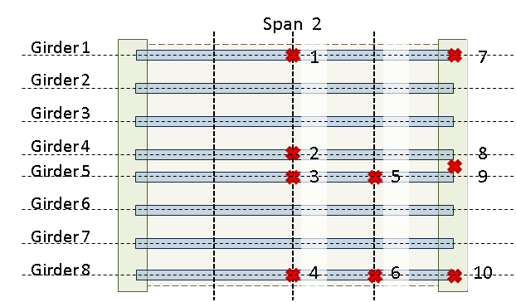
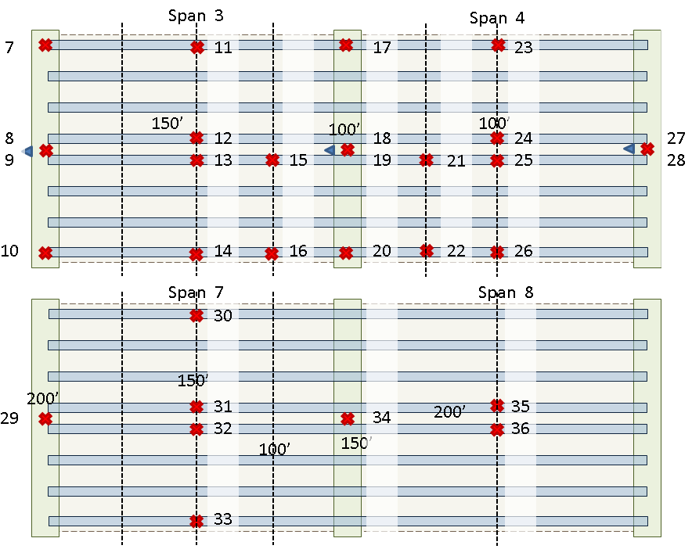
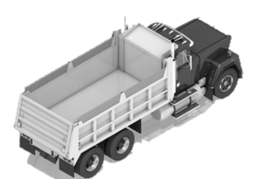
Phase 4 – Instrumentation
Bridge
36 accelerometers located to capture primary modes of vibration and peak response for spans 2, 3, 4, 7 and 8.
2 strain gauges placed on the bottom flange at mid-span of span 3 on girders 4 and 5 (to be sampled at 20Hz).
Accelerometers sampled by NI cRIO at 1652 Hz. GPS time also recorded for synchronization between DAQs.
Truck
4 accelerometers oriented vertically at the 4 corners of the truck bed to characterize load movement.
1 accelerometer oriented longitudinally to record acceleration of truck travel
1 accelerometer held by truck passenger for “tap-to-mark” meta data recording
Accelerometers sampled by NI cRIO at 1652 Hz. GPS time recorded to synchronize with bridge DAQs
Tandem dump truck (3 axles) filled with crushed rock provided by PennDOT

Slide 27
Phase 4 – Test Execution
Sensors were installed on the bridge on June 26th and 27th of 2017. On June 28th the test truck was acquired, weighed and instrumented. The testing took place between 10 am and 3 pm of June 28th.
14 passes were made by the test truck over the bridge
Truck velocity ranged from 10 mph to 60 mph
Both sides of the bridge and all 4 lanes were traversed
Passes were made in various traffic conditions (light traffic, medium traffic, heavy traffic)
Passes were made between 10:20 am and 12:20 pm
Video was recorded at 3 locations: the ends of the bridge and above span 2 facing spans 3 & 4
Additional data was recorded of the operational response on the afternoon of June 28th and the early morning of June 29th
All sensors were removed from the bridge on Thursday June 29th.

Slide 28
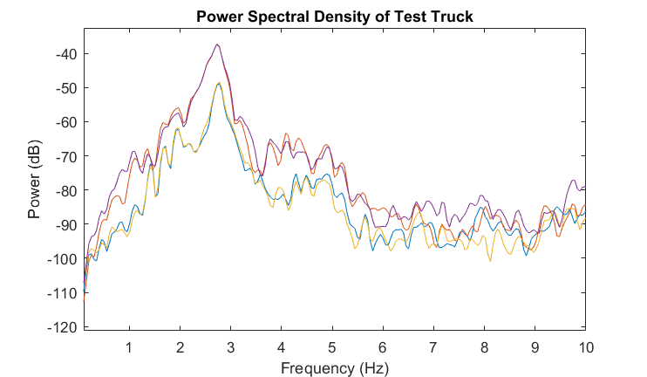
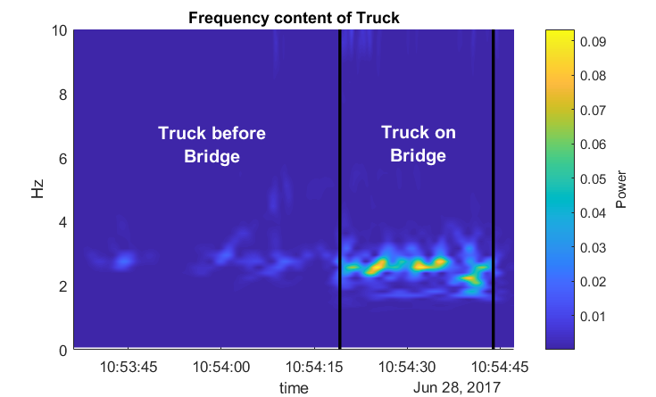
Phase 4 – Vehicle Response
The first mode: all 4 degrees of freedom moving up and down together (in phase) and is centered near 3 Hz
Because of the high degree of non-linearity inherent to the truck suspension, the peak is very broad with much of the vibration between 1.5 and 3.5 Hz
The magnitude of vertical acceleration greatly increases as soon as the truck enters the bridge
The first mode between 2 and 3 Hz is excited when traversing the bridge
Acceleration magnitude quickly drops after exiting the bridge

Slide 29
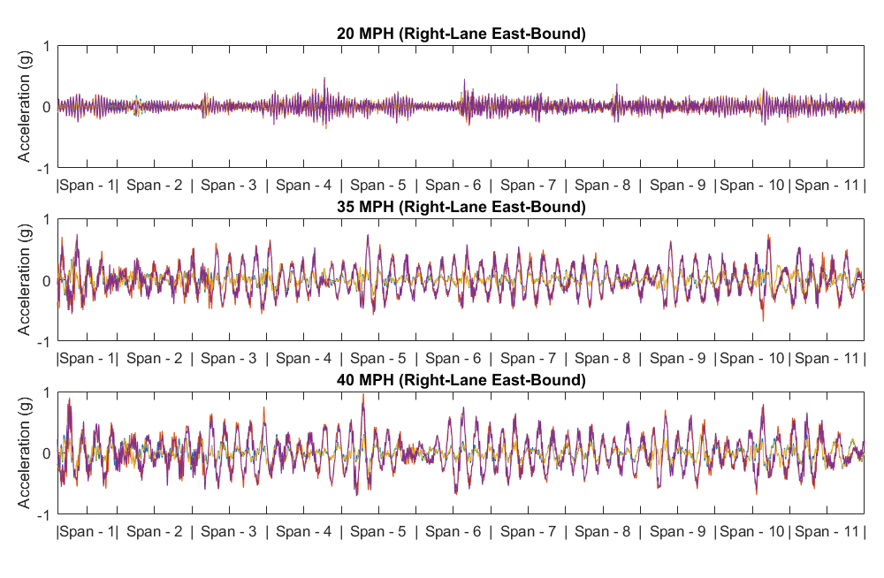
Phase 4 – Vehicle Response
Examining the truck acceleration at different speeds but in the same lane reveals that the truck experiences much higher vibration magnitudes at higher speeds (>30 mph).
Approximate proportional increase in acceleration with vehicle speed

Slide 30
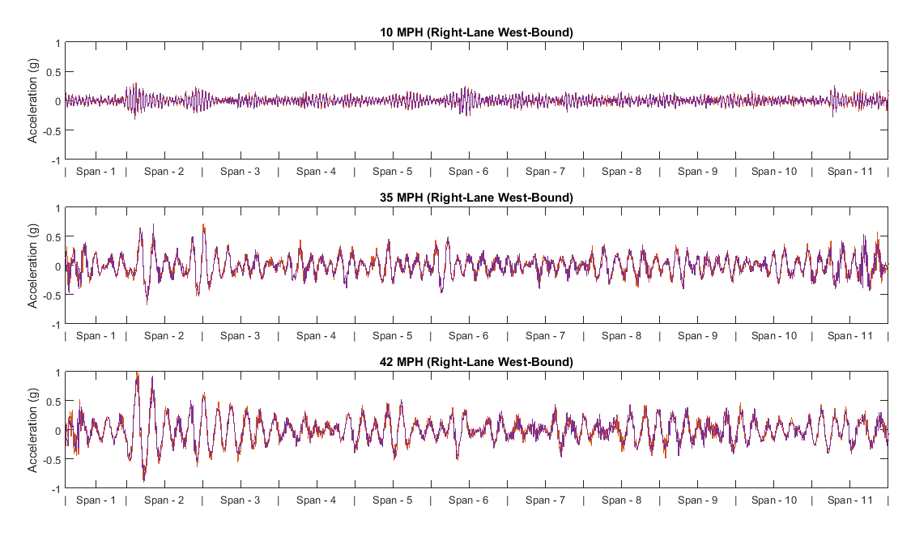
Phase 4 – Vehicle Response
Both east bound and west bound show similar behavior

Slide 31
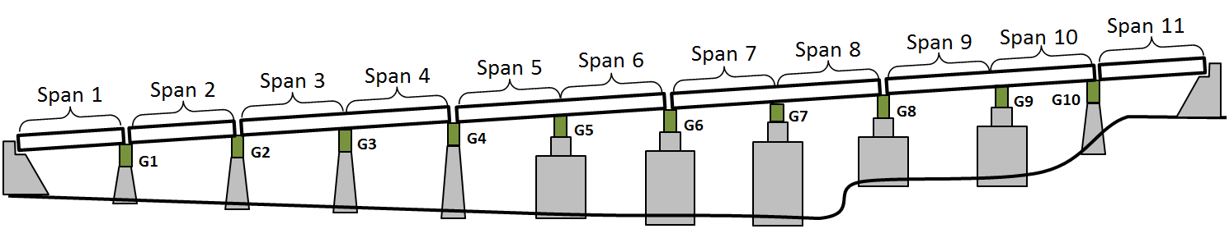

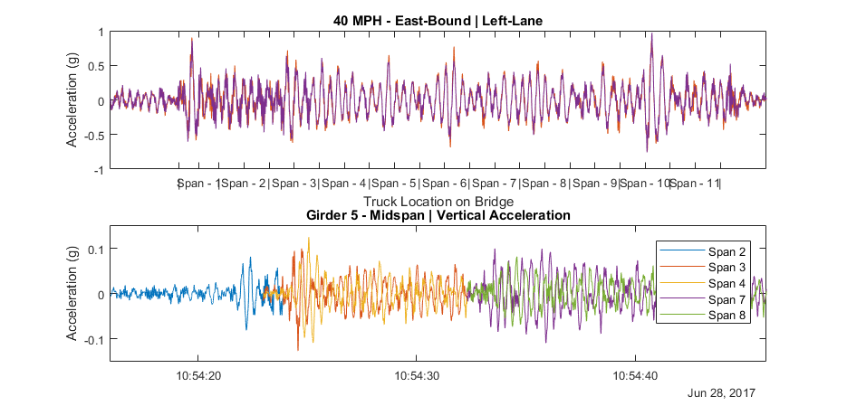
Phase 4 – Bridge-Vehicle Response

Slide 32
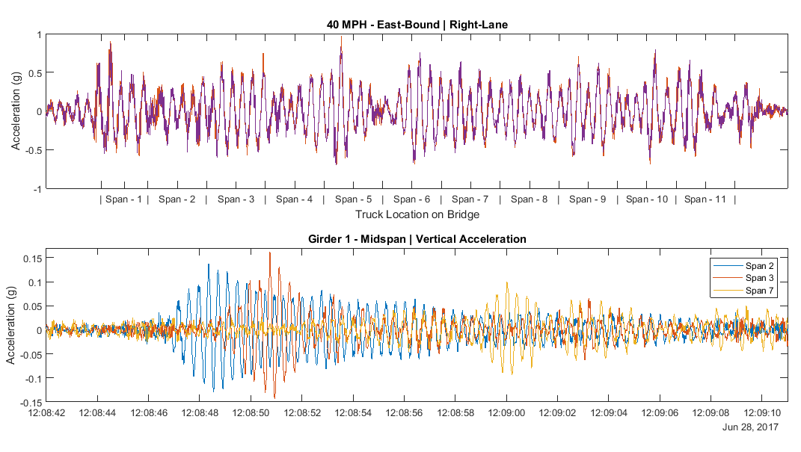
Phase 4 – Bridge-Vehicle Response
Truck acceleration increases upon entering the bridge
Certain locations along the bridge cause a jump in truck acceleration
The bridge is excited by test truck, each span quickly transitioning to high vibration once truck enters the span.
The truck experiences nearly 10x the magnitude of acceleration as that experienced by the bridge

Slide 33
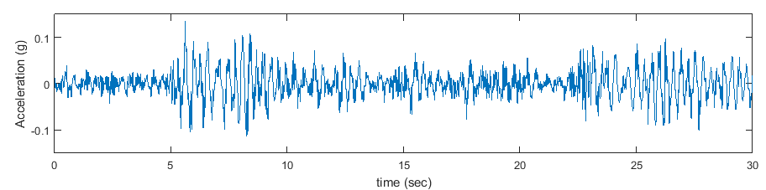
Phase 4 – Response Comparison
Phase 4 Response
Phase 2 Response – Girder 5 Midspan of span 7

Slide 34
Phase 4 – Conclusions
The bridge is excited by the test vehicle
The test vehicle experiences much higher vibration when on the bridge
The test vehicle experiences higher vibration at higher speeds
Resulting hypotheses:
The profile of the bridge is such that it causes large vibrations in the test vehicle, especially at higher speeds, consequently increasing the loads felt by the structure.
The natural modes of vibration of the bridge are very similar to that of the test vehicle (and traffic), thus the vehicle is able to drive the structure’s modes.
The non-linearity and damping of the test vehicle (and traffic) allow the vibration of the bridge to tune the vehicle response to match the bridge.
The low frequency modes of the structure, its low damping, and the proximity of mode frequencies to those of traffic, create a scenario in which the bridge vibration is easily induced and resonates for a long period of time, thus making it easier for the next event to cause high vibrations

Slide 35
Research Scope (Crawl, Walk, Run)
Phase 2 – Detailed characterization of selected span(s), including strains, displacements, modal frequencies, and mode shapes
Phase 1 – Quantify the levels and spatial variation of vibration
Phase 3 – Development and calibration of an FE model for the viaduct
Phase 4 – Synchronized bridge/vehicle monitoring
Vehicle System
Interface
Bridge System
Phase 6 – Direct measurement of bridge profile
Phase 5 – Simulation of bridge/vehicle interaction
“Digital Twin”

Slide 36
Phase 5 – Vehicle-Bridge Interaction
Armed with data describing the behavior of both the bridge and traversing vehicle we can further investigate the nature of the vehicle-bridge interaction through the use of a representative model or “digital twin”.
For this effort we utilized the capabilities of LUSAS: a commercial FE software that has tools for analyzing moving vehicles (sprung-mass) over a modeled structure.
A number of models were created with increasing levels of complexity, each made with dynamic properties matching those of the real structure as determined in previous testing.
Ranging from 2 spans to the entire viaduct
Single side of the bridge to both sides
Single-line model to full 3D representation

Slide 37
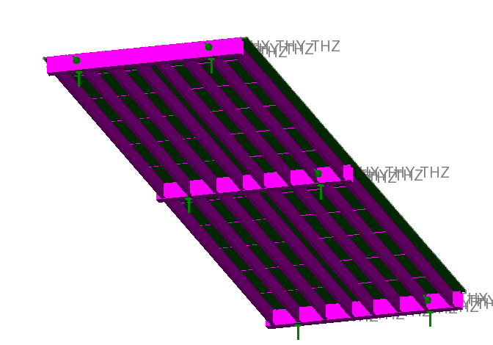
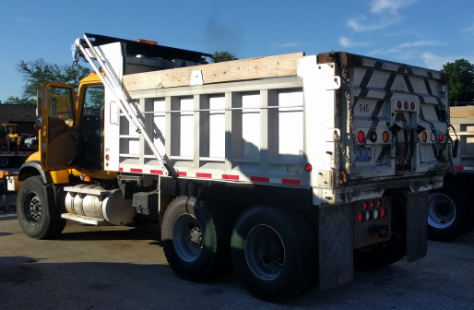
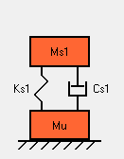
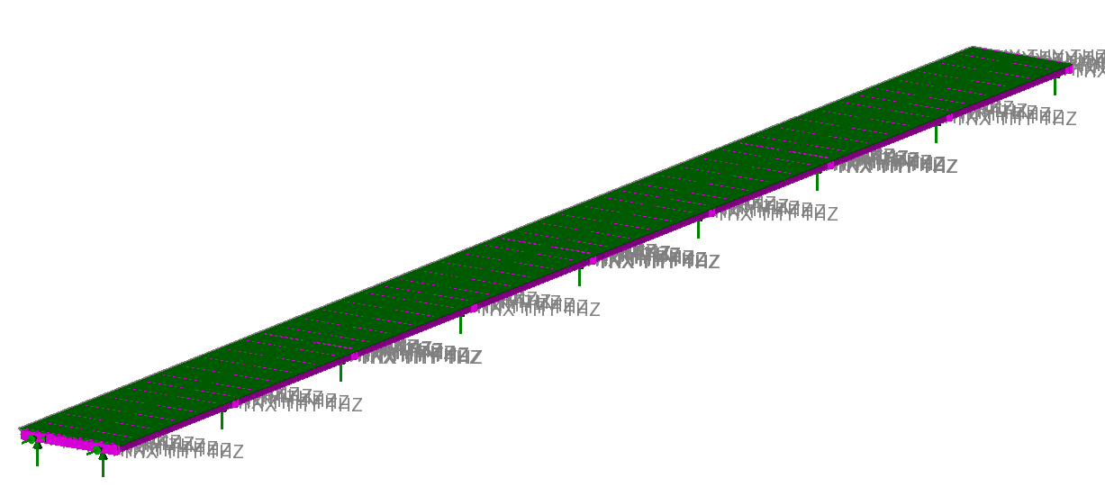
Phase 5 Modeling Construction

Slide 38
Phase 5 Modeling Efforts
With the representative models created and a vehicle model based on the measured truck weight and suspension characteristics derived from the truck’s frequency response, we were able to simulate the test scenarios.
Our goal was to recreate several attributes from the test results:
Peak truck acceleration
Pattern of truck acceleration
Structure acceleration
Default Vehicle Parameters
Mass (kip) | 48
Suspension stiffness (k/in) | 33
Damping (lb-s/in) | 2025
Damping Ratio | 0.5
initial excitation
typ. peak amplitudes
apparent beating

Slide 39
Phase 5 Modeling Efforts
Simulations with the modeled vehicle and bridge were run for various scenarios
Speeds ranging from 0.5 to 70 mph
1 to 26 vehicles, regularly and randomly spaced
Vehicle damping ratios from 0 to 1
Various profiles
No Profile
Overcamber
Undercamber
¼” sine function
Estimated from LiDAR

Slide 41
Phase 5 Modeling Efforts: Preliminary Results

Slide 42
Phase 5 Modeling Efforts: Preliminary Results

Slide 43
Phase 5 Modeling Efforts: Preliminary Results
Summary of preliminary modeling conclusions
Response of structure is dependent on it’s initial conditions (i.e. already vibrating from preceding vehicles)
Effects from the profile of the roadway preceding the bridge damp out quickly and thus only have an effect on the responses of the beginning region of the bridge
The profile of the bridge roadway is very influential to vehicle and bridge response
Profiles with wavelengths of 20 to 40 feet create the largest responses under normal traffic speeds (30-60mph)

Slide 44
Research Scope (Crawl, Walk, Run)
Phase 2 – Detailed characterization of selected span(s), including strains, displacements, modal frequencies, and mode shapes
Phase 1 – Quantify the levels and spatial variation of vibration
Phase 3 – Development and calibration of an FE model for the viaduct
Phase 4 – Synchronized bridge/vehicle monitoring
Vehicle System
Interface
Bridge System
Phase 6 – Direct measurement of bridge profile
Phase 5 – Simulation of bridge/vehicle interaction
“Digital Twin”

Slide 45
Phase 6 - Future Work
After performing the preliminary vehicle-bridge interaction modeling, it is clear that capturing the profile of the I-76 bridge is essential to recreating the responses measured during testing.
We are in the process of issuing a contract to measure the roadway profile with an Ames Engineering Model 8300 Portable Profiler.
Once acquired, further simulation will be conducted with the goal of recreating those responses.
Subsequently we will conduct a parametric study in an effort to identify structure and traffic parameters that cause high vibration and large dynamic amplification.

Slide 46
By December Meeting
If profile is measured
Phase 3 (design vs. in-situ) completed
Profile used in simulations
New simulation results presented
If no profile
Phase 3 (design vs. in-situ) completed
More formal representation of preliminary simulation work

Slide 47
Additional Material

Slide 48
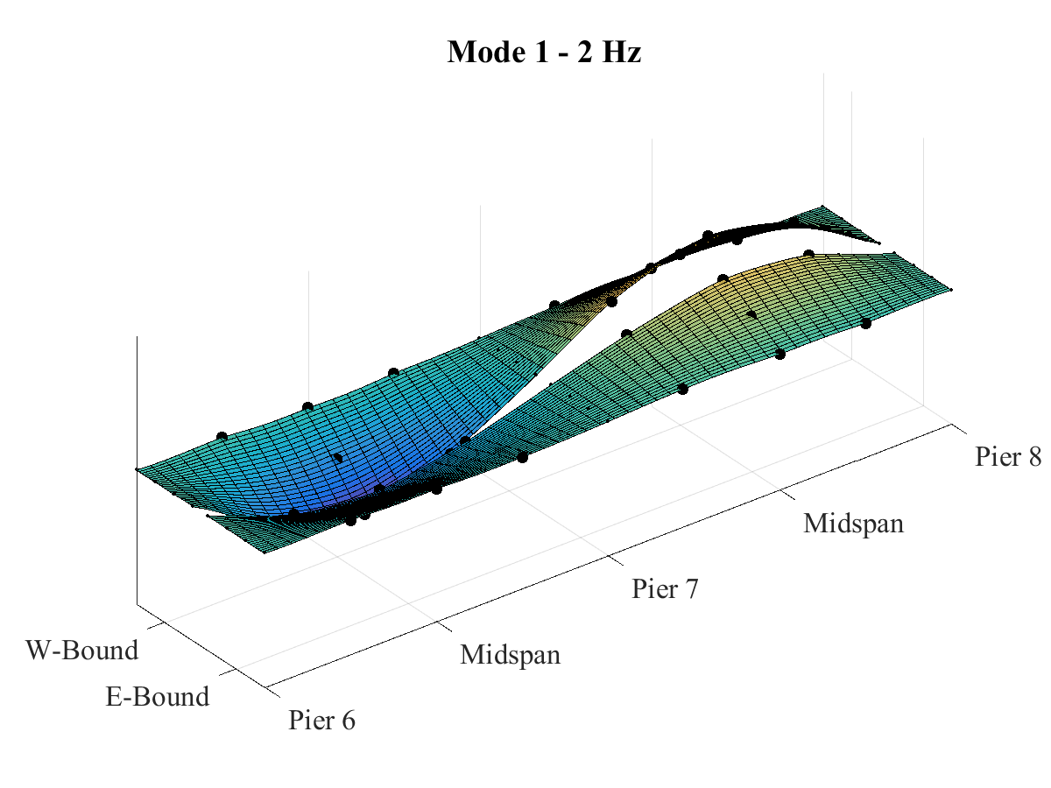
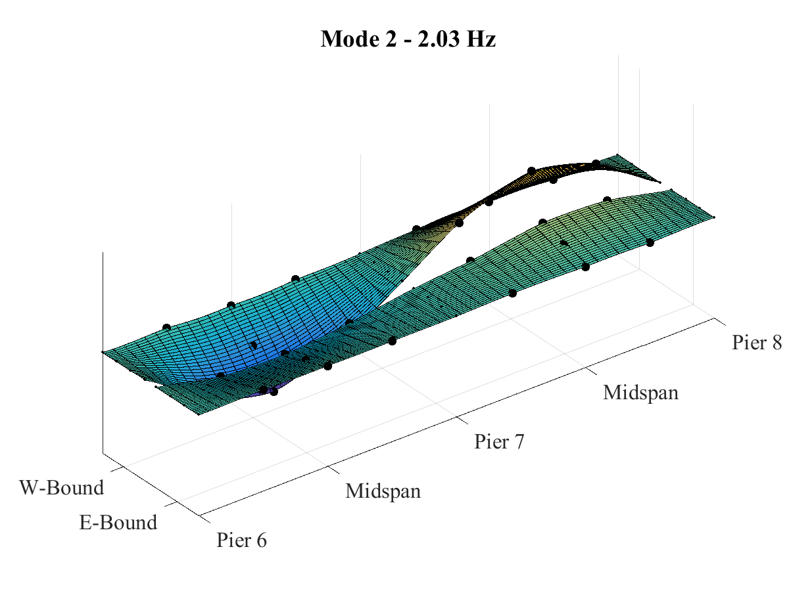
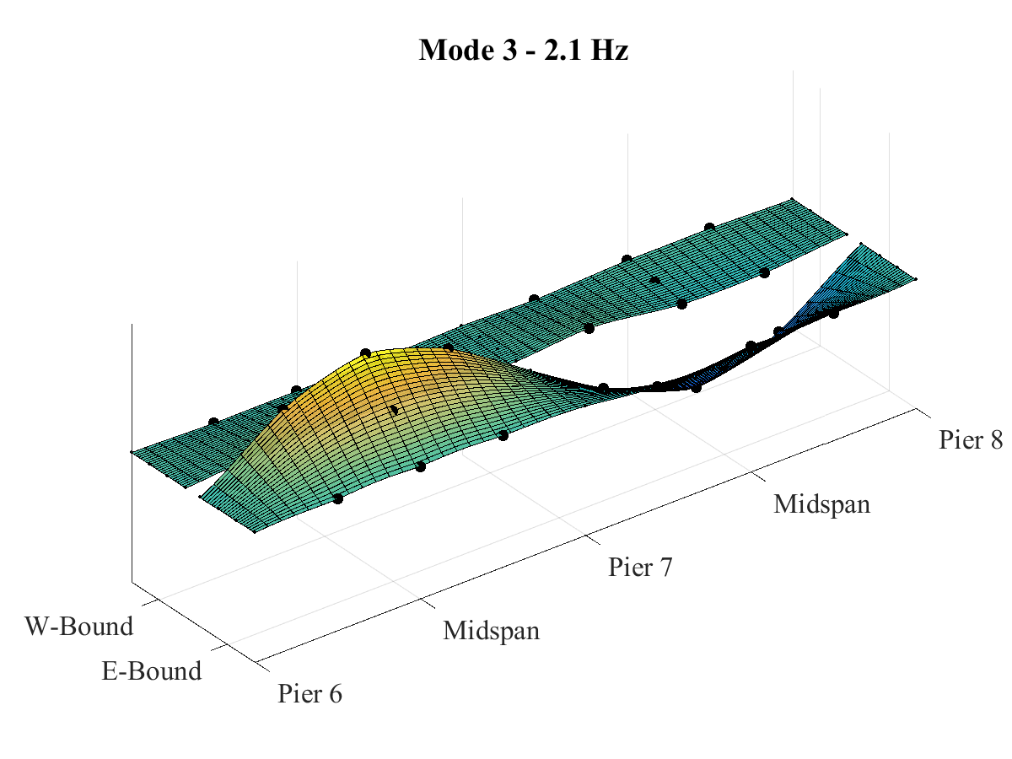
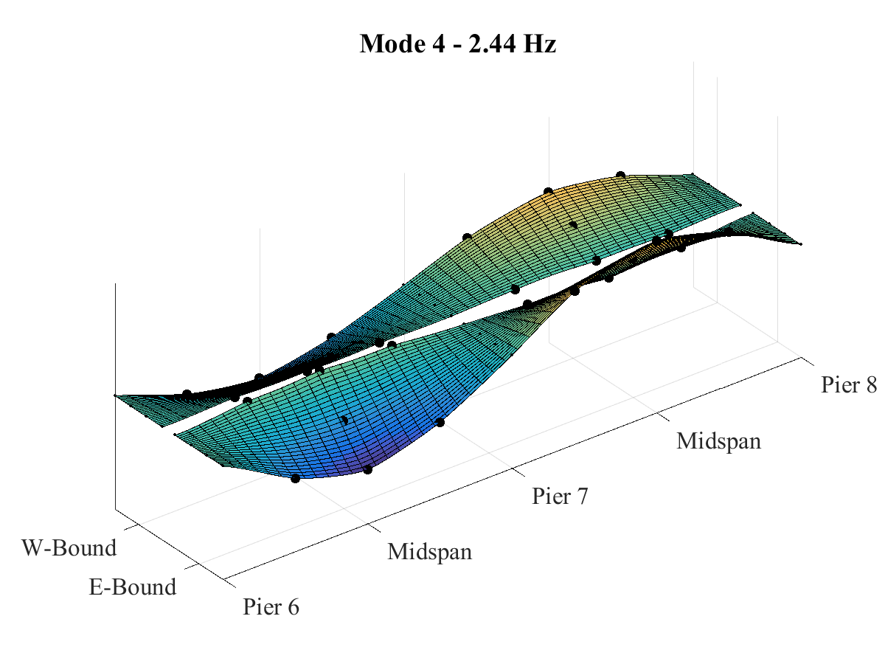
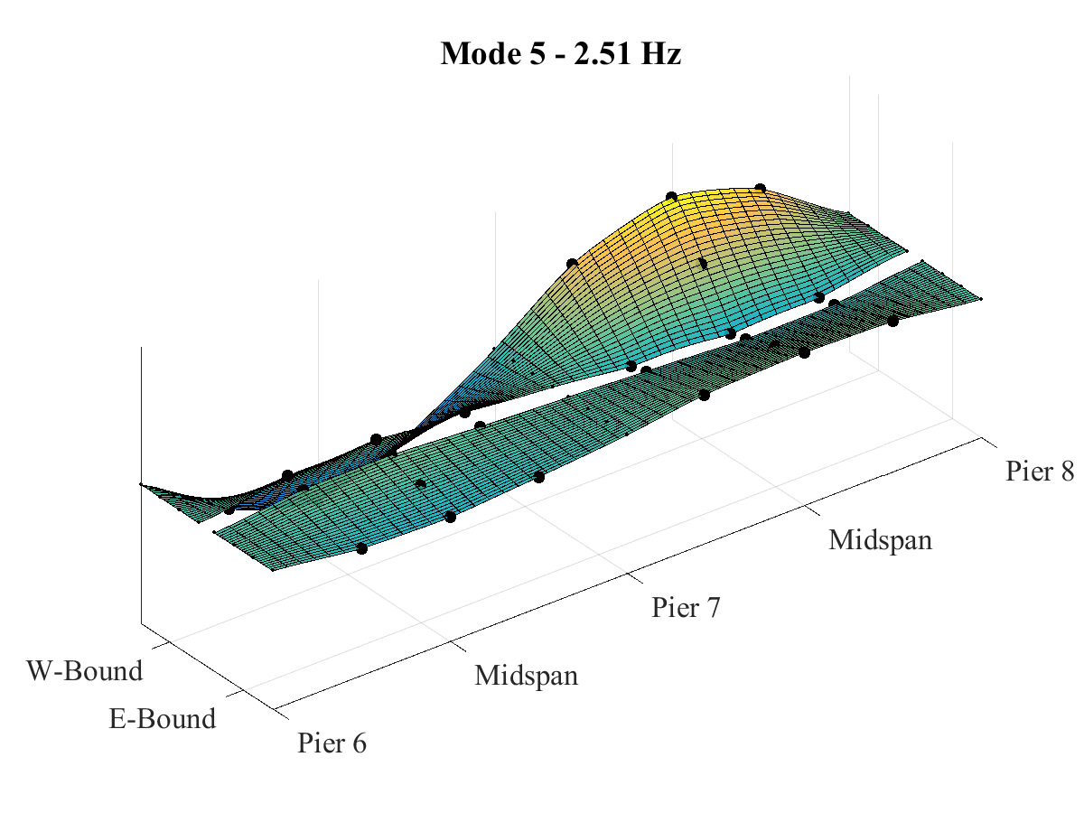
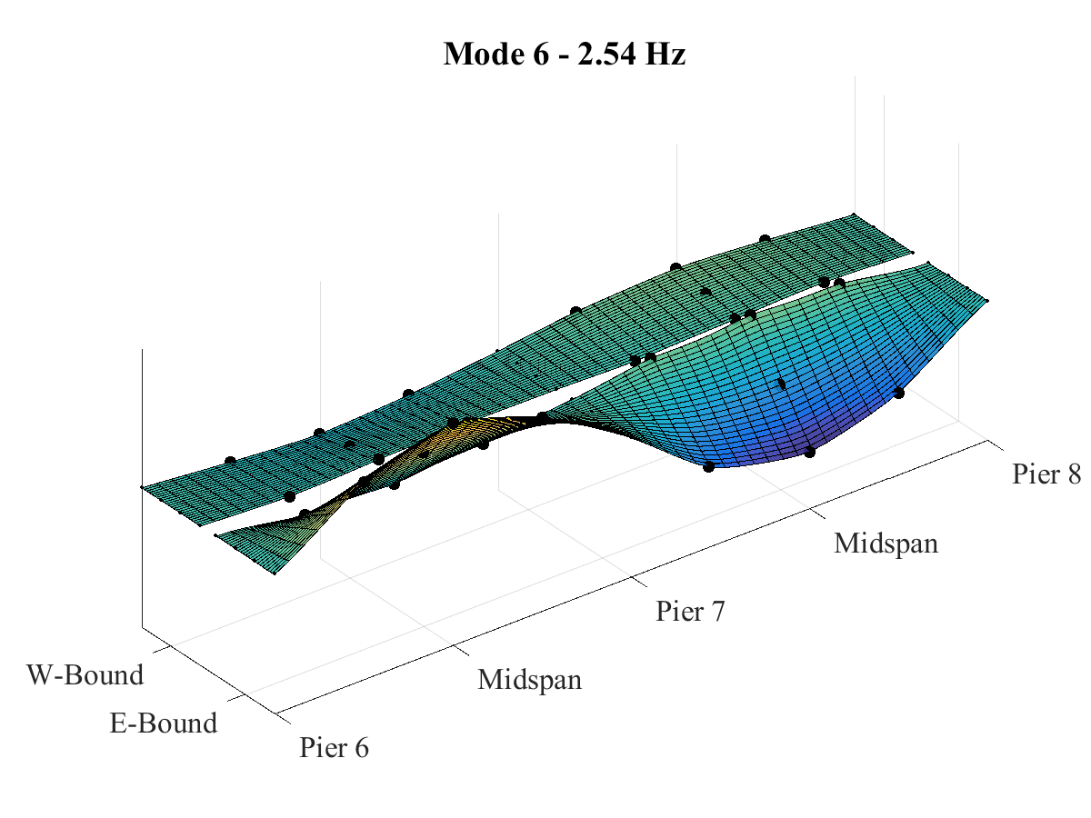
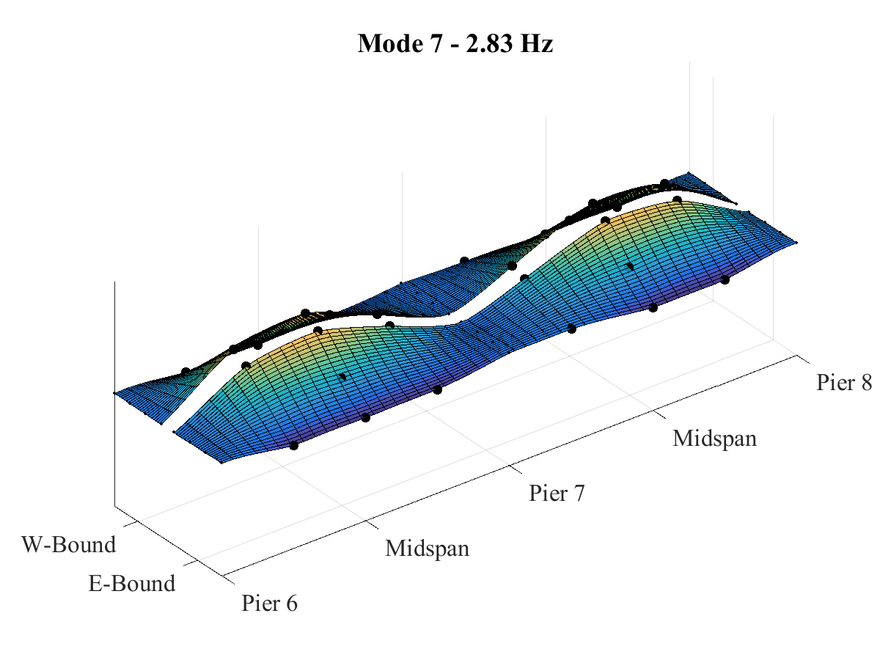
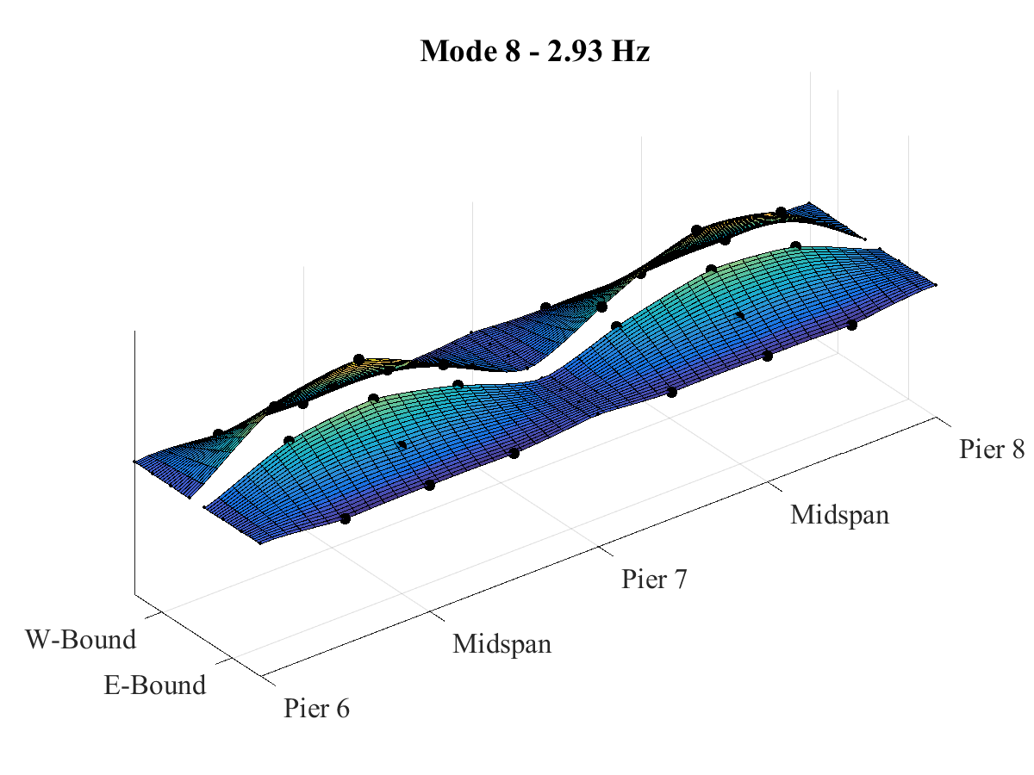
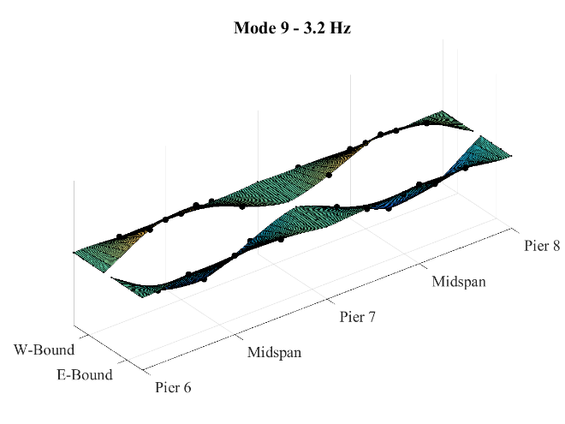
Mode Shapes

Slide 49
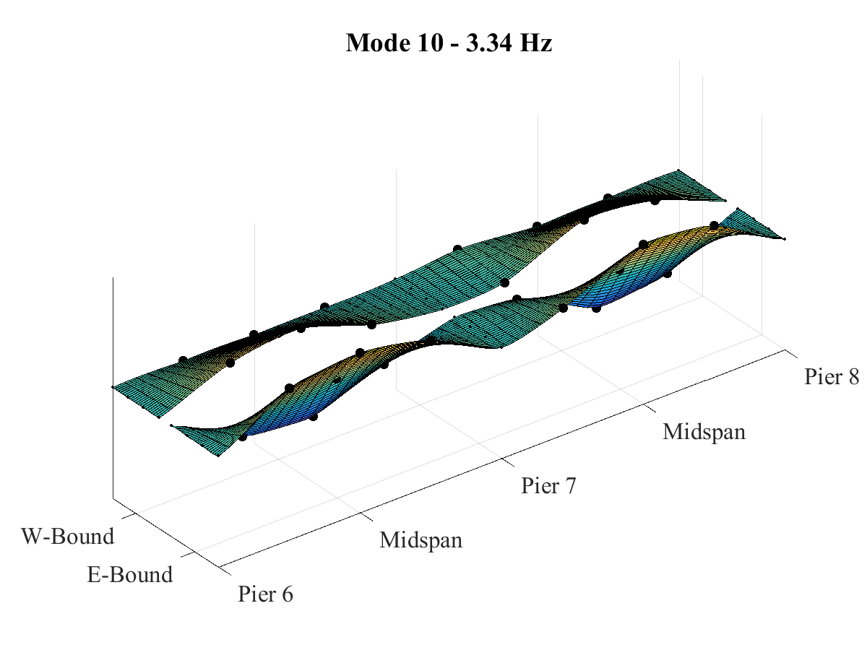
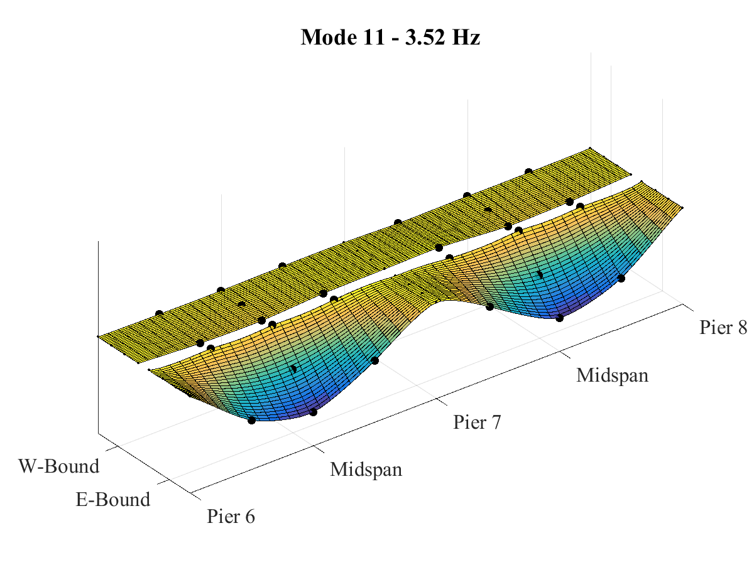
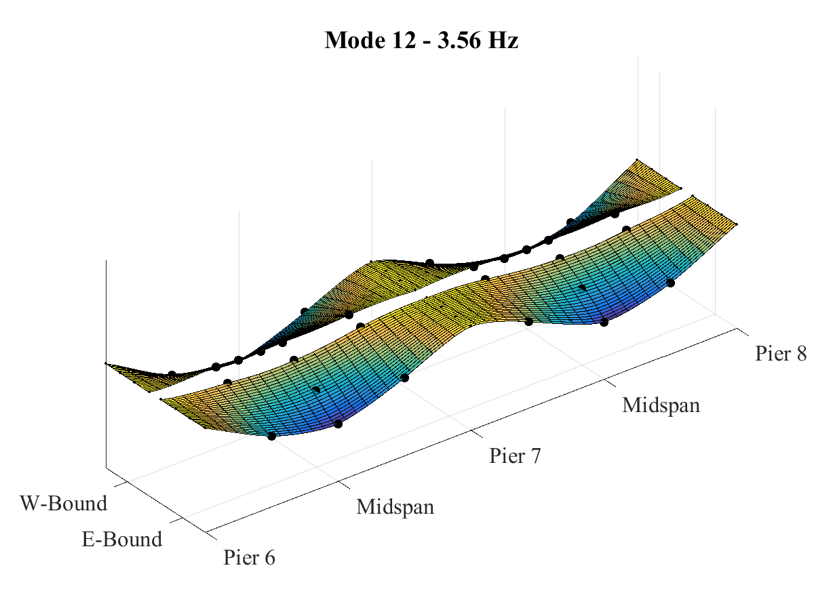






Mode Shapes

